Slide 1
EE451: High Voltage Engineering
Lecture 09

Slide 2
Outline
Breakdown Mechanism in Gases
Towsend’s current growth equation
Current growth in the presence of secondary processes
Towsend’s criteria for breakdown
Time-lags for breakdown
Volt-time curves
Page 2

Slide 3
Introduction
The first step which lead to breakdown is the process of ionization.
When an electron collides with a neutral atom or molecule, a positive ion and an electron are formed. This is called an ionizing collision.
This releases additional electrons which accelerate and collide with further atoms, releasing more electrons — a chain reaction.
There is an exponential growth of the charged particles, and these charged particles develop in the form of an avalanche.
The initial process of ionization in a gaseous dielectric caused by applied electric field would result in an electron avalanche.
The complete breakdown of the dielectric is the advanced stage when an unlimited growth of current is produced.
Page 3

Slide 4

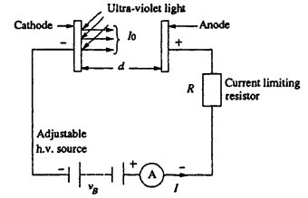
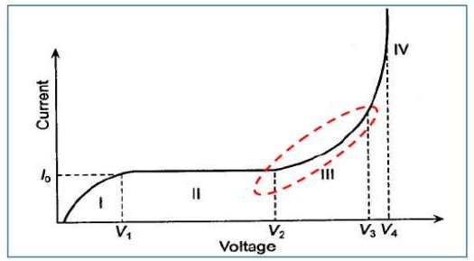


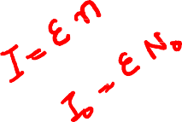







Townsend’s Current Growth Equation
Consider a parallel plate capacitor having gas as an insulating medium and separated by a distance d as shown in figure.
When no electric field is set up between the plates, a state of equilibrium exists between the state of electron and positive ion generation due to the decay processes.
Page 4

Slide 5
Townsend’s Current Growth Equation
This state of equilibrium will be disturbed moment a high electric field is applied. The variation of current as a function of voltage was studied by Townsend.
He found that the current at first increased proportionally as the voltage is increased and then remains constant, at I₀ which corresponds to the saturation current. At still higher voltages, the current increases exponentially.
The variation of current as a function of voltage is shown in figure.
The exponential increase in current is due to ionization of gas by electron collision. As the voltage increases V/d increases and hence the electrons are accelerated more and more and between collisions these acquire higher kinetic energy and, therefore, knock out more and more electrons.
Page 5

Slide 6

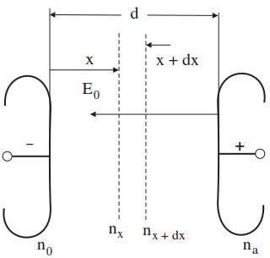




Townsend’s Current Growth Equation
To explain the exponential rise in current, Townsend introduced a coefficient known as Townsend’s first ionization coefficient α.
When one electron collides with a neutral atom, a positive ion and an electron are formed. This is called ionizing collision.
Hence, α is defined as the number of electrons produced by an electron through ionization collision per unit length of path in the direction of field.
Page 6

Slide 7

Townsend’s Current Growth Equation
Let n₀ = number of electrons leaving the cathode. At distance x from the cathode, let the number of electrons produced by collisions become n_{X}.
When these n electrons move through a distance dx produce additional dn_{X}
electrons due to collision.
where x is the distance form the cathode, α the Townsend’s ionization coefﬁcient, and n_{X} the number of electrons at distance x from the cathode.
By integrating above equation and applying the initial condition, n_{x} = n₀ at x = 0,
Now at x = 0, n = n₀. Therefore,
Page 7

Slide 8






































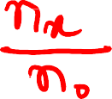
















Slide 9

Townsend’s Current Growth Equation
Thus, the number of electrons striking the anode (at x = d), per second is,
This means that on average, each electron leaving the cathode produces (e^{αd} − 1) new electrons and the same number of positive ions in traversing the distance d .
Finally, in terms of current,
where I₀ is the initial current at the cathode.
The term e^{αd} is called the electron avalanche and represents the exponential growth in the number of electrons produced by one electron through ionizing collisions (primary processes) in travelling from cathode to anode.
Page 9

Slide 10



Townsend’s Current Growth Equation
In other words, Townsend’s first ionization coefficient α represents the average number of ionizing collisions made by an electron per unit length across the gap in a uniform field.
It is a function of the electric field intensity E, and at constant temperature it is dependent upon the gas pressure p, that is,
Page 10

Slide 11
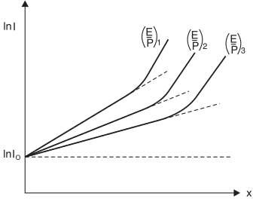
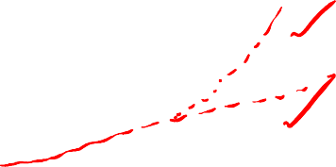
Current Growth in the Presence of Secondary Processes
From the equation
Taking anti-log on both sides,
This is a straight line equation with slope α and intercept ln I₀ if for a given pressure p, E is kept constant.

Slide 12

Current Growth in the Presence of Secondary Processes
Townsend in his earlier investigations had observed that the current in parallel plate gap increased more rapidly with increase in voltage as compared to the one given by the above equation.
To explain this departure from linearity, Townsend suggested that a secondary mechanism in addition to primary α-processes must be affecting the current.
These secondary processes involve emission of electrons from the cathode by the following effects:
Positive ion effect
Photon effect
Metastable effect

Slide 13
Current Growth in the Presence of Secondary Processes
Positive ion effect “γ_{ion}”: While the positive ions produced in the primary avalanche cannot gain enough kinetic energy in the electric field to ionize molecules, they may have sufficient potential energy to cause ejection of electrons upon striking the cathode.
Photon effect “γ_{p}”: Excited molecules in the avalanche may emit photons on returning back to their ground state of the energy level. This radiation falling on cathode may produce photo-emission of electrons.
Metastable effect “γ_{m}”: Molecules in metastable condition may diffuse back to the cathode and cause electron emission on striking.

Slide 14



Current Growth in the Presence of Secondary Processes
Thus, in practice, positive ions, photons and metastable, all the three may participate in the process of ionization. It depends upon the experimental conditions.
There may be more than one mechanism producing secondary ionization in the discharge gap.
Therefore, it is customary to express the net secondary ionization effect by a single coefficient γ, known as Townsend’s second ionization coefficient.
γ is defined as the average number of secondary electrons released from the cathode per incident positive ion, photon or metastable atoms (through primary process).
It should be noted that γ may represent one or more of the several possible mechanism:

Slide 15



Current Growth in the Presence of Secondary Processes
γ strongly depends upon the cathode material and it is a function of ﬁeld intensity and pressure of the gas,
The current in region III has a much steeper rise until breakdown occurs, which is rendered to the γ or secondary process.
Townsend’s current growth equation in this region is derived as follows:
Let n₀ = number of electrons emitted from cathode by primary process (UV radiation) per second
n₀′ = number of secondary electrons released from the cathode per second
n₀′′ = total number of electrons leaving the cathode per second then,

Slide 16






Current Growth in the Presence of Secondary Processes
Since each electron leaving the cathode makes on an average (e^{αd} − 1) collisions in the gap, therefore, the total number of ionizing collisions per second in the gap will be n₀′′(e^{αd} − 1).
By deﬁnition, γ is the number of secondary electrons produced on an average at the cathode per ionizing collision in the gap, then,
Substituting,

Slide 17



Current Growth in the Presence of Secondary Processes
The number of electrons arriving at the anode is given by,
Substituting the value of n₀′′ in the above equation,
Under the steady state conditions, the total current in the gap can be given by,
The above equation describes the growth of average current in the gap before the breakdown.

Slide 18

Townsend’s Criterion for Breakdown
When voltage between the anode and cathode is increased, the current at the anode is given by,
In the above equation, γ (e^{αd} -1) represents μ, that is, mean number of secondary electrons produced per avalanche.
Following two conditions are possible:
Case 1: μ << 1
The equation reduces to I = I₀ e^{αd}, which represents the region III.
In this case, the applied voltage and hence, field intensity is low so that secondary ionization or γ-process is insignificant.
This condition is referred as non self-sustaining discharge or ionization process under which a breakdown would not be able to develop itself.

Slide 19
Townsend’s Criterion for Breakdown
Case 2: μ ≈ 1
As the applied voltage and thus, the electric field intensity is increased, the value of μ approaches 1.
The denominator of the equation approaches zero and therefore, the current I tends to increase unlimitedly.
At this stage, the current is limited by external impedance of the circuit.
Under these conditions, the discharge or ionization process become self-sustained to maintain the level of required charge carriers, described as self-sustaining discharge.

Slide 20





Townsend’s Criterion for Breakdown
The quantitative condition for the breakdown can be expressed as:
μ = γ (e^{αd} - 1) = 1
This equation is known as Townsend’s criteria for spark breakdown in a uniform field.
At the final stage of breakdown, the electron amplification is much higher than one
_{(e}αd
>> 1), so the equation reduces to:
γe^{αd} = 1
Page 20

Slide 21
Time Lags for Breakdown
The mechanism of spark breakdown is considered as a function of ionization processes under uniform field conditions.
But in practical engineering designs, the time to breakdown due to rapidly changing voltages or impulse voltages is of considerable practical importance.
Actually, there is a time difference between the application of a voltage sufficient to cause breakdown and the occurrence of breakdown itself. This time difference is called the time lag.
Townsend criterion for breakdown is satisfied, only if at least one electron is present in the gap between the electrodes.
In the case of applied d.c. or slowly varying (50 Hz a.c) voltages, there is no difficulty in satisfying this condition.

Slide 22

Time Lags for Breakdown
The reason being that the duration of a.c. and d.c. voltages is sufficiently large so that there are usually sufficient initiatory electrons created by cosmic ray and naturally occurring radioactive sources.
However, with rapidly varying voltages of short duration (~ 10⁻⁶ s), the initiatory electron may not be present in the gap, and in the absence of such an electron breakdown cannot occur.
The time t which lapses between the application of the voltage sufficient to cause breakdown and the appearance of the initiating electron is called a statistical time lag (t_{s}) of the gap.
After the appearance of the electron, a time t_{t} is required for the ionization processes to develop fully to cause the breakdown of the gap, and this time is called the formative time lag (t_{f}).

Slide 23
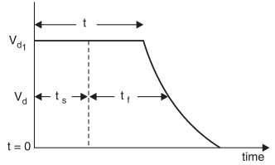

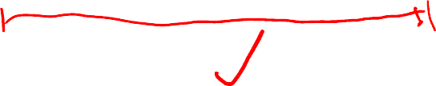
Time Lags for Breakdown
The total time lag is the addition of statistical and formative time lag.
t = t_{s} + t_{f}
Suppose V_{d} is the maximum value of d.c. voltage applied for a long time to cause breakdown of a given gap. Let the same gap be subjected to a step voltage of peak value V_{d1} > V_{d} and of a duration such that the gap breaks down in time t.

Slide 24

Volt-time Curves
The volt-time characteristics of different electrical apparatus, which are very important in insulation co-ordination studies.
Insulation coordination means the correlation of the insulation of the various equipment in a power system to the insulation of the protective devices used for the protection of those equipment against overvoltages.
The breakdown voltage of a gap is a function of two parameters:
Magnitude of applied voltage
Time of application of the voltage
The volt-time curve is a graph showing the relation between the crest flashover voltages and the time to flashover for a series of impulse applications of a given wave shape.

Slide 25

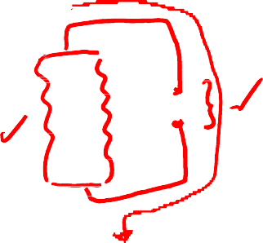
Volt-time Curves
In a power system various equipments like transformers, sphere gaps, rod gaps, bushing etc. have different breakdown voltages and hence, the volt-time characteristics.
In order that all the equipments should be properly protected, it is desired that the insulation of the various protective devices must be properly coordinated.
It can be seen that a rod gap will protect a bushing if volt-time curve of rod gap lie below that of bushing.
Similarly, a sphere gap is required for the complete protection of a transformer against high voltage surges.

Slide 26
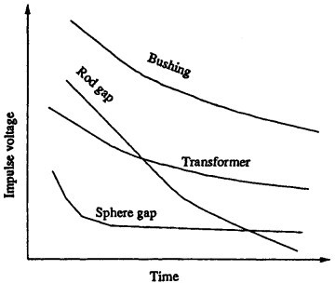

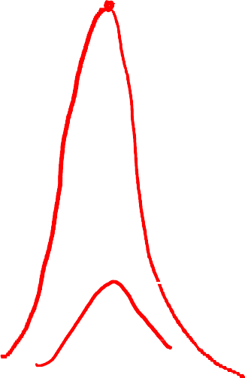

Volt-time Curves

Slide 27
Volt-time Curves
For the construction of volt-time curve, impulse voltages of the same shape but of different peak values are applied to the insulation.
Following procedure is adopted:
If flashover occurs on the front of the wave, the flashover point gives one point on the volt-time curve.
If the flashover occurs just at the peak value; this gives another point on the volt- time curve.
If the flashover occurs on the tail side of the wave, draw a horizontal line from the peak value of this wave and also draw a vertical line passing through the point where the flashover takes place. The intersection of the horizontal and vertical lines gives the point on the volt-time curve.

Slide 28
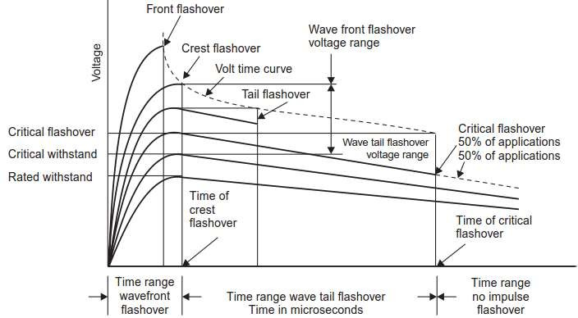


Volt-time Curves

Slide 29
THANK YOU FOR YOUR ATTENTION

